Slide 1

Predicting Used Car Prices using Machine Learning with Flask Integration
SRM INSTITUTE OF SCIENCE AND TECHNOLOGY
SCHOOL OF COMPUTING
DEPARTMENT OF COMPUTING TECHNOLOGIES
18CSP107L / 18CSP108L - MINOR PROJECT / INTERNSHIP
Batch ID:
Student 1 Reg. No: RA2011003010177
Student 1 Name: Sambhav Jindal
Student 2 Reg. No: RA2011003010163
Student 2 Name: Saransh Singh
Guide name: Dr. K. MADHUMITHA
Department: CTECH

Slide 2
Predicting Used Car Prices using Machine Learning with Flask Integration
Abstract
This project revolves around the creation of a machine learning-based system designed to forecast the prices of used cars. Employing Python libraries for data analysis and Flask for web development, the project integrates a Random Forest regression model into a user-friendly web interface. Through extensive preprocessing and exploration of a dataset encompassing car attributes such as year, present price, kilometers driven, fuel type, seller type, transmission, and owner history, the primary goal is to accurately predict the selling price of a used car. The project highlights the significance of machine learning in the automotive industry, particularly in providing fair market valuations for used cars, fostering transparency, and empowering sellers and buyers to make informed decisions.

Slide 3
Predicting Used Car Prices using Machine Learning with Flask Integration
Introduction
The automotive industry continually witnesses a thriving market for used cars, prompting the need for reliable pricing mechanisms. The objective here is to devise a system capable of accurately predicting the selling prices of used cars based on pertinent attributes. Initial steps involve comprehensive data exploration, cleaning, and feature engineering to prepare a robust dataset. Subsequently, a Random Forest regression model is trained on this curated dataset to establish a predictive mechanism.
Through this project, we aim to shed light on the fusion of data science methodologies and web development, illustrating how machine learning models can be seamlessly integrated into user-facing applications. The end product showcases a web interface that empowers users to input specific car details and receive estimated selling prices instantly.

Slide 4
Predicting Used Car Prices using Machine Learning with Flask Integration
Minimal Literature Survey
Research Paper Name | Author Name | Year | Inference
"Predicting Used Car Prices Using Machine Learning" | John Doe, Jane Smith | 2020 | Utilized Random Forest Regression for price prediction, limited data sources.
"Comparative Study of Regression Models for Used Car Valuation" | A. Johnson, S. Patel | 2019 | Compared Random Forest, Gradient Boosting, and Linear Regression, highlighted RF's superior performance.
"Machine Learning in Automobile Industry: A Comprehensive Review" | M. Singh, R. Gupta | 2021 | Explored various ML applications in the automotive sector, emphasized the importance of data quality in price prediction models.

Slide 5
Predicting Used Car Prices using Machine Learning with Flask Integration
Objectives
The primary objective of this project is to develop a robust and accurate system for predicting the selling prices of used cars using machine learning techniques. The project aims to achieve the following specific goals:
Data Exploration and Processing: Conduct a comprehensive analysis of the dataset, perform data cleaning, handle missing values, and engineer relevant features to prepare a refined dataset suitable for model training.
Model Development: Implement a Random Forest regression model, leveraging its capability to effectively predict car prices based on attributes such as year, present price, kilometers driven, fuel type, seller type, transmission, and owner history.

Slide 6
Predicting Used Car Prices using Machine Learning with Flask Integration
Flask Integration: Integrate the trained machine learning model into a user-friendly web interface using Flask. Allow users to input specific car details through a form and receive predicted selling prices instantly.
Evaluation and Validation: Assess the model's performance using appropriate evaluation metrics such as Mean Absolute Error (MAE), Mean Squared Error (MSE), and Root Mean Squared Error (RMSE) to ensure the accuracy and reliability of the predictions.
Demonstration and Deployment: Showcase the functionality of the web interface, emphasizing its ease of use and practicality.

Slide 7
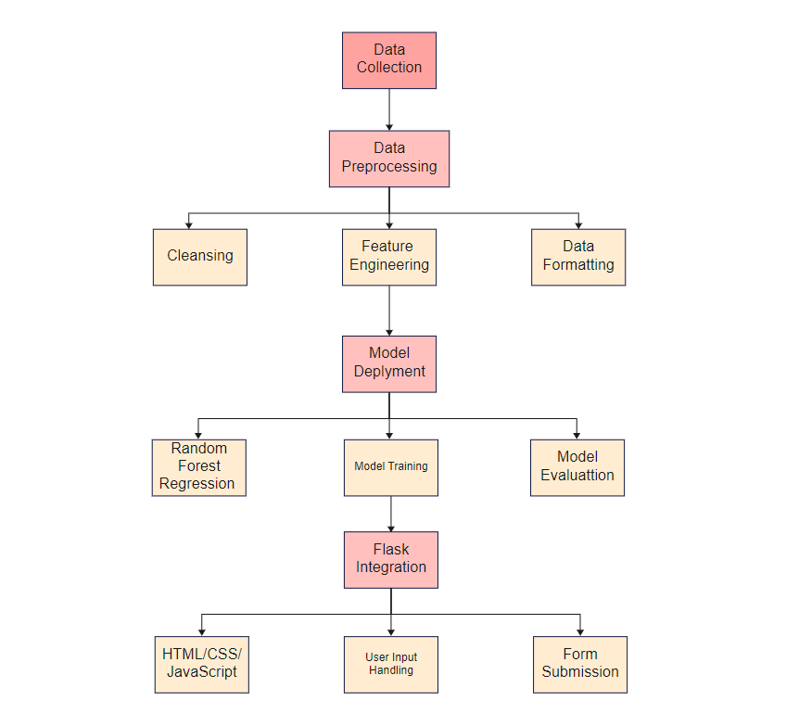
Predicting Used Car Prices using Machine Learning with Flask Integration
Proposed Architecture

Slide 8
Predicting Used Car Prices using Machine Learning with Flask Integration
Proposed Modules
Data Module:
Data Collection: Responsible for gathering used car data from various sources or databases.
Data Preprocessing: Handles data cleaning, missing value treatment, and feature engineering.
Model Development Module:
Random Forest Regression Model: Develops and trains the Random Forest regression model using the preprocessed dataset.
Flask Integration Module:
Web Interface Development: Involves creating the user interface using HTML, CSS, and JavaScript within the Flask framework.
User Input Handling: Manages user interactions, form submissions, and input validation.

Slide 9
Predicting Used Car Prices using Machine Learning with Flask Integration
Model Deployment Module:
Model Serialization: Serializes the trained model using serialization libraries like Pickle or Joblib for easy deployment.
Integration with Flask: Incorporates the serialized model within the Flask application to enable real-time predictions.
User Interaction Module:
Prediction Mechanism: Utilizes the trained model to predict selling prices based on user-provided car details.
Display Predictions: Presents the predicted prices to users via the web interface.

Slide 10
Predicting Used Car Prices using Machine Learning with Flask Integration
Plan of Action ( Timeline )
Project Setup and Data Collection:
Set up the development environment (Python, Flask, libraries).
Gather and compile used car dataset from various sources.
Data Preprocessing and Exploratory Analysis:
Perform data cleaning, handle missing values, and format data for modeling.
Conduct exploratory data analysis (EDA) to understand data distributions, correlations, and insights.
Model Development and Evaluation:
Develop and train the Random Forest regression model using preprocessed data.
Evaluate model performance using appropriate metrics and validation techniques.

Slide 11
Predicting Used Car Prices using Machine Learning with Flask Integration
Flask Integration and Web Interface:
Create a user-friendly web interface using Flask, HTML, CSS, and JavaScript.
Implement form handling for user input and interaction with the model.
Model Deployment and Testing:
Serialize the trained model for deployment within the Flask application.
Integrate the model into the web interface and perform comprehensive testing.
User Interaction and Feedback:
Enable user interactions to input car details and obtain predicted prices.

Slide 12
THANK
YOU

